Slide 1
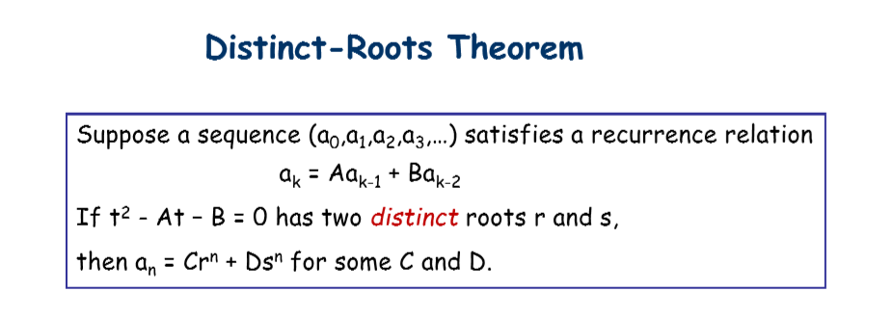

Slide 2
Question 1
Let a₀, a₁, a₂, … be the sequence defined by the recursion relation, a_{k} = 3a_{k-1} - 2a_{k-2} for all integers k ≥ 2.
(a) Show that the explicit formula a_{n} = C 2^{n} + D, where C and D are real numbers.
(b) For a₂ = 1, a₃ = -15, determine the value of C and D

Slide 3
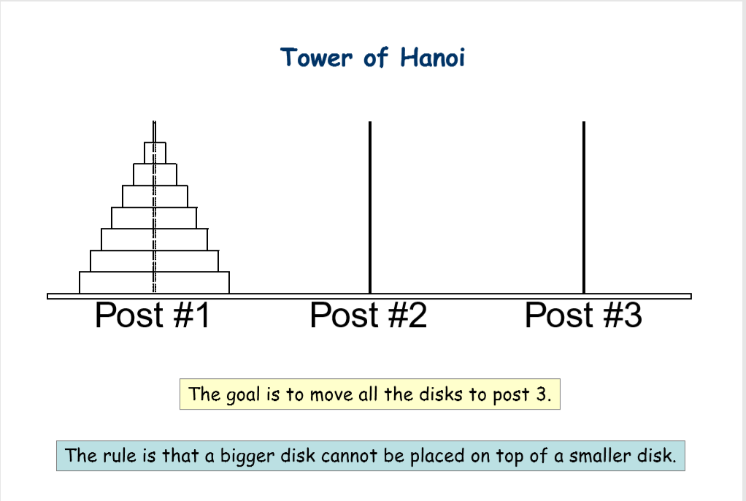

Slide 4
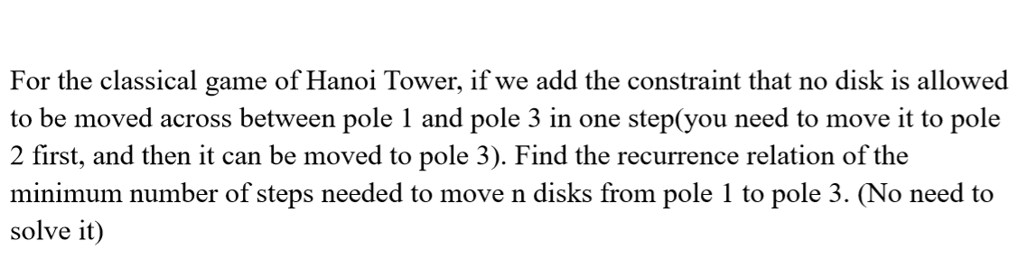
Question 2

Slide 5
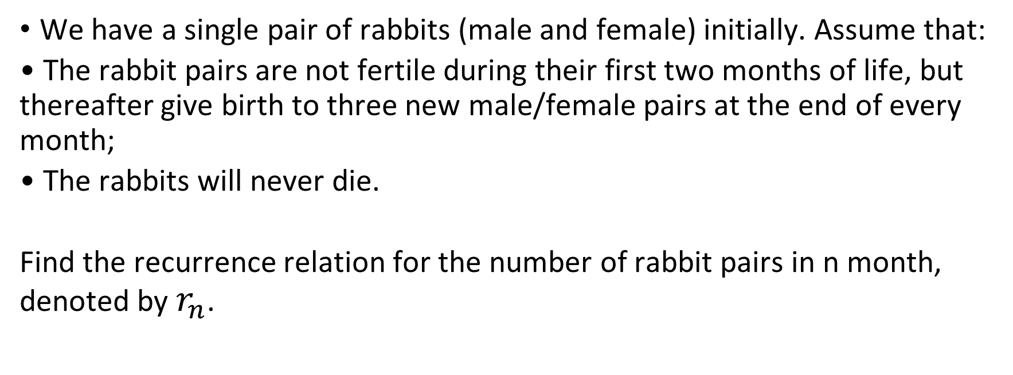
Question 3
We have a single pair of rabbits (male and female) initially. Assume that:
• The rabbit pairs are not fertile during their first two months of life, but thereafter give birth to three new male/female pairs at the end of every month;
• The rabbits will never die.
Find the recurrence relation for the number of rabbit pairs in n month, denoted by $r_{n}$.

Slide 6
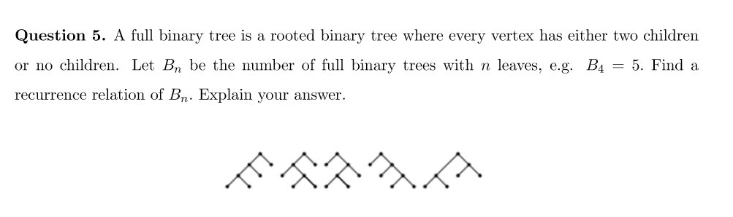

Slide 7
